Slide 1
Introduction to Text Analytics in R
Marvin Marino

Slide 2
AGENDA
Why it matters?
A Simple Text Analysis
Lets do it in R!

Slide 3
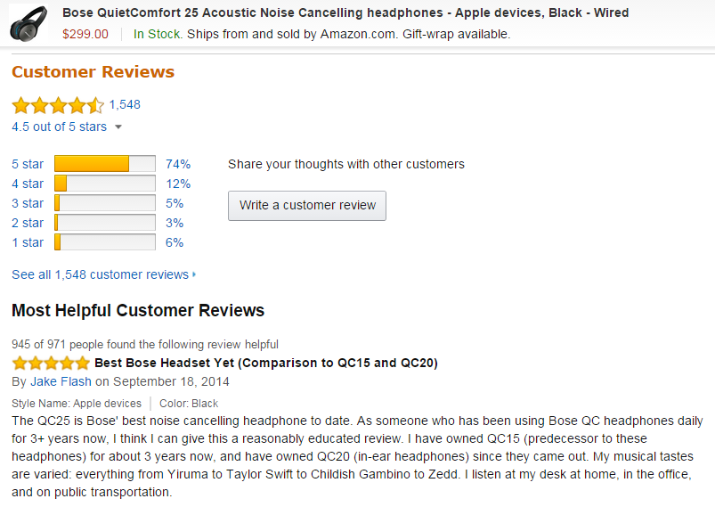

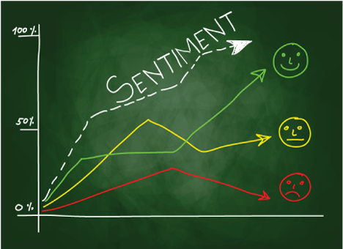


WITH TEXT ANALYTICS WE AIM TO SUMMARIZE, MAKE SENSE AND EXCTRACT ACTIONABLE INSIGHTS FROM UNSTRUCTURED DATA.

Slide 4
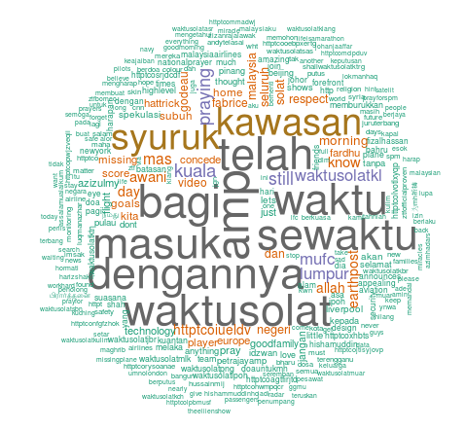
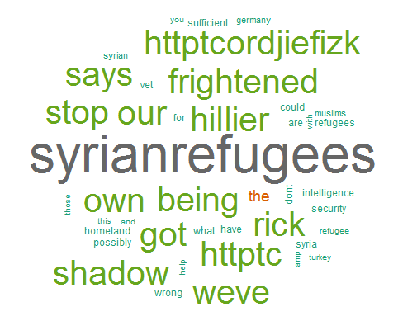
SUMMARIZING TEXT WITH A WORDCLOUD IS A SIMPLE FIRST STEP INTO GAINING INSIGHTS.
Word cloud from #PrayForMH370 Malaysia Airlines
Word cloud from #Syrianrefugees

Slide 5
A SIMPLE TEXT ANALYSIS: PROCESS
Get Data
Parse data from Twitter via and Load data into R
Clean the Corpus
Customize filtering to be applied, such as:
Stopwords (German, English).
Numbers, punctuation, replace spaces.
Specific words.
Select how many words should be considered (i.e. Tokenizer) ➔ 1-gram, 2-grams?
Decide which weighting methodology ➔ Word Counts or TF-IDF score?
Text
Generate TDM
Term Document Matrix is generated
Text
Plot
Wordcloud
Export Word Counts and plot Word Clouds

Slide 6
R time!

